Slide 1
Section 3.3: More Check Digit Systems
Math for Liberal Studies

Slide 2
A New Method
None of the methods we have investigated so far can detect transposition errors
In this section we will investigate new method that can detect these errors
These methods involve weighted sums

Slide 3
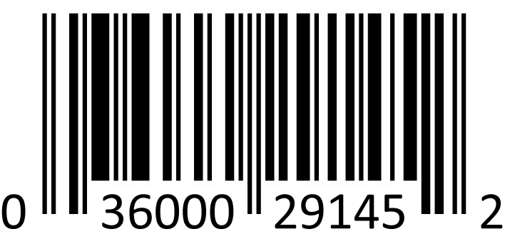
UPC (Universal Product Code)
Here is an example of a UPC from a typical product
Notice that there are 12 digits: a single digit, two groups of 5, and another single digit
category
of goods
check digit
manufacturer ID
product ID

Slide 4
Parts of the UPC
The first digit represents the “category of goods”
Most fixed-weight products are in category 0
Coupons are in category 5
The next 5 digits identify the manufacturer
For example, Coca-Cola is 49000
The next 5 digits identify the particular product
For example, a 12 oz. can of Diet Coke is 01134
The last digit is the check digit

Slide 5
Computing the Check Digit
Instead of adding all of the digits together, we do something a little more complex
Multiply the first digit by 3
Add the second digit
Add the third digit multiplied by 3
Add the fourth digit
etc.
The check digit is chosen so that this sum ends in 0
Notice that we include the check digit in our sum!

Slide 6
Weighted Sums
This is called a weighted sum
In a weighted sum, we multiply the digits by “weights” before adding them together
In this case, the weights are:
3, 1, 3, 1, 3, 1, 3, 1, 3, 1, 3, 1

Slide 7
An Example
Show that 0-52800-48826-7 is valid

Slide 8
An Example
Show that 0-52800-48826-7 is valid
Digit | 0 | 5 | 2 | 8 | 0 | 0 | 4 | 8 | 8 | 2 | 6 | 7
Weight | 3 | 1 | 3 | 1 | 3 | 1 | 3 | 1 | 3 | 1 | 3 | 1
Product | 0 | 5 | 6 | 8 | 0 | 0 | 12 | 8 | 24 | 2 | 18 | 7

Slide 9
An Example
Show that 0-52800-48826-7 is valid
Add these products together: 0+5+6+8+0+0+12+8+24+2+18+7 = 90
Digit | 0 | 5 | 2 | 8 | 0 | 0 | 4 | 8 | 8 | 2 | 6 | 7
Weight | 3 | 1 | 3 | 1 | 3 | 1 | 3 | 1 | 3 | 1 | 3 | 1
Product | 0 | 5 | 6 | 8 | 0 | 0 | 12 | 8 | 24 | 2 | 18 | 7

Slide 10
An Example
Show that 0-52800-48826-7 is valid
Add these products together: 0+5+6+8+0+0+12+8+24+2+18+7 = 90
This total ends in zero, so the UPC is valid
Digit | 0 | 5 | 2 | 8 | 0 | 0 | 4 | 8 | 8 | 2 | 6 | 7
Weight | 3 | 1 | 3 | 1 | 3 | 1 | 3 | 1 | 3 | 1 | 3 | 1
Product | 0 | 5 | 6 | 8 | 0 | 0 | 12 | 8 | 24 | 2 | 18 | 7

Slide 11
Detecting Errors
Suppose the UPC 0-37000-38593-6 is reported as 0-73000-38593-6
Is this transposition error detected?

Slide 12
Detecting Errors
Determine if 0-73000-38593-6 is valid
Add these products together: 0+7+9+0+0+0+9+8+15+9+9+6 = 72
This total doesn’t end in 0, so it’s invalid
Digit | 0 | 7 | 3 | 0 | 0 | 0 | 3 | 8 | 5 | 9 | 3 | 6
Weight | 3 | 1 | 3 | 1 | 3 | 1 | 3 | 1 | 3 | 1 | 3 | 1
Product | 0 | 7 | 9 | 0 | 0 | 0 | 9 | 8 | 15 | 9 | 9 | 6

Slide 13
Detecting Errors
The UPC system detects all substitution errors and 89% of all transposition errors
However, because of the repeating pattern of weights, this system cannot detect any jump transposition errors

Slide 14
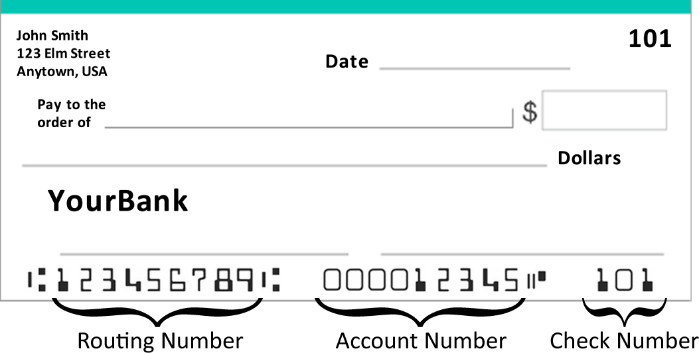
Another System: Bank Routing Numbers

Slide 15
What’s a Routing Number?
A routing number uniquely identifies a bank
If you have direct deposit on your paychecks, your employer asked you for your routing number (or for a cancelled check to read the number from)
Also listed on your checks are your account number and the specific check number

Slide 16
Check Digits on Checks
Routing numbers are 9 digits long
The 9th digit is a check digit
To determine if the routing number is valid, compute a weighted sum with the weights 7, 3, 9, 7, 3, 9, 7, 3, 9
If this sum ends in 0, then the number is valid

Slide 17
Example
Show that 111000025 is a valid routing number (this is the routing number for a bank in Texas)

Slide 18
Example
Show that 111000025 is a valid routing number (this is the routing number for a bank in Texas)
We add up all of these products and get 70, which ends in 0, so the number is valid
Digit | 1 | 1 | 1 | 0 | 0 | 0 | 0 | 2 | 5
Weight | 7 | 3 | 9 | 7 | 3 | 9 | 7 | 3 | 9
Product | 7 | 3 | 9 | 0 | 0 | 0 | 0 | 6 | 45

Slide 19
Detecting Errors
The bank routing number system detects substitution errors and most transposition errors, just like the UPC system
However, because of the more complex weight pattern, the bank routing number system can detect some jump transposition errors as well

Slide 20
ISBN: International Standard Book Number
There are different kinds of ISBN
The simplest are 10 digits long

Slide 21
ISBN: International Standard Book Number
The group identifier shows the country (or group of countries) in which the book was published
The publisher number identifies the publisher

Slide 22
ISBN: International Standard Book Number
The title number identifies the book itself, and is chosen by the publisher
The check digit is computed with a weighted sum

Slide 23
Weighted Sums Again
For an ISBN number, the weighted sum is computed with weights 10, 9, 8, 7, 6, 5, 4, 3, 2, 1
If the weighted sum is evenly divisible by 11, then the number is valid

Slide 24
An Example
Let’s check the ISBN 0-6714-8183-5
Adding up the products, we get: 0+54+56+7+24+40+4+24+6+5 = 220
220 is divisible by 11, so this number is valid
Digit | 0 | 6 | 7 | 1 | 4 | 8 | 1 | 8 | 3 | 5
Weight | 10 | 9 | 8 | 7 | 6 | 5 | 4 | 3 | 2 | 1
Product | 0 | 54 | 56 | 7 | 24 | 40 | 4 | 24 | 6 | 5

Slide 25
Detecting Errors
Is this substitution error detected? 0-6714-6183-5
The weighted sum is 210, which is not divisible by 11
So the error is detected
Digit | 0 | 6 | 7 | 1 | 4 | 6 | 1 | 8 | 3 | 5
Weight | 10 | 9 | 8 | 7 | 6 | 5 | 4 | 3 | 2 | 1
Product | 0 | 54 | 56 | 7 | 24 | 30 | 4 | 24 | 6 | 5

Slide 26
Finding the Right Check Digit
Which check digit should be used for the ISBN 0-5199-4003-◻?

Slide 27
Finding the Right Check Digit
Which check digit should be used for the ISBN 0-5199-4003-◻?
The weighted sum is 196 + ?
Digit | 0 | 5 | 1 | 9 | 9 | 4 | 0 | 0 | 3 | ?
Weight | 10 | 9 | 8 | 7 | 6 | 5 | 4 | 3 | 2 | 1
Product | 0 | 45 | 8 | 63 | 54 | 20 | 0 | 0 | 6 | ?

Slide 28
Finding the Right Check Digit
We want to find a digit so that 196 plus that digit is divisible by 11
If we divide 196 by 11, we get a remainder of 9
So we use a check digit of 2, we get a total of 198, which is divisible by 11

Slide 29
Finding the Right Check Digit
Here’s another example 0-7167-1910-◻
This time, the weighted sum is 199 + ?
If we divide 199 by 11, we get a remainder of 1, but that means we would need to use 10 for the check digit to make the total divisible by 11
When this happens, we use X for the check digit (X is the Roman numeral for 10)
So the valid ISBN is 0-7167-1910-X

Slide 30
The Luhn Algorithm
A credit card number is 16 digits long, and the 16th digit is the check digit
The method for computing the check digit is a modified version of a weighted sum
This method is called the Luhn algorithm

Slide 31
The Luhn Algorithm
Use the weight pattern 2, 1, 2, 1, 2, 1, etc., but if multiplying a digit by 2 would result in a two-digit number, add the two digits together (so if you double 8, you would write down 1+6 = 7 instead of 16)
Add up all the results: if the resulting sum ends in 0, then the ID number is valid

Slide 32
An Example
Consider the credit card number 4128 0012 3456 7896
Adding up these “products,” we get 70
Since the total ends in 0, the number is valid
Digit | 4 | 1 | 2 | 8 | 0 | 0 | 1 | 2 | 3 | 4 | 5 | 6 | 7 | 8 | 9 | 6
Weight | 2 | 1 | 2 | 1 | 2 | 1 | 2 | 1 | 2 | 1 | 2 | 1 | 2 | 1 | 2 | 1
“Product” | 8 | 1 | 4 | 8 | 0 | 0 | 2 | 2 | 6 | 4 | 1 | 6 | 5 | 8 | 9 | 6

Slide 33
Detecting Errors
The Luhn algorithm detects all substitution errors, and every transposition error except 09 ↔ 90
Just like the UPC system, the Luhn algorithm cannot detect jump transposition errors because of the repeating weight pattern

